Slide 1
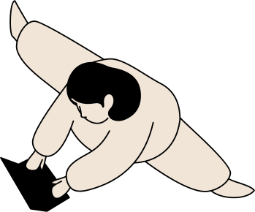
?IPA Chart
Lesson 6-7: Other Vowels and Consonants
#THEHOMESCHOOLLIFE

Slide 2
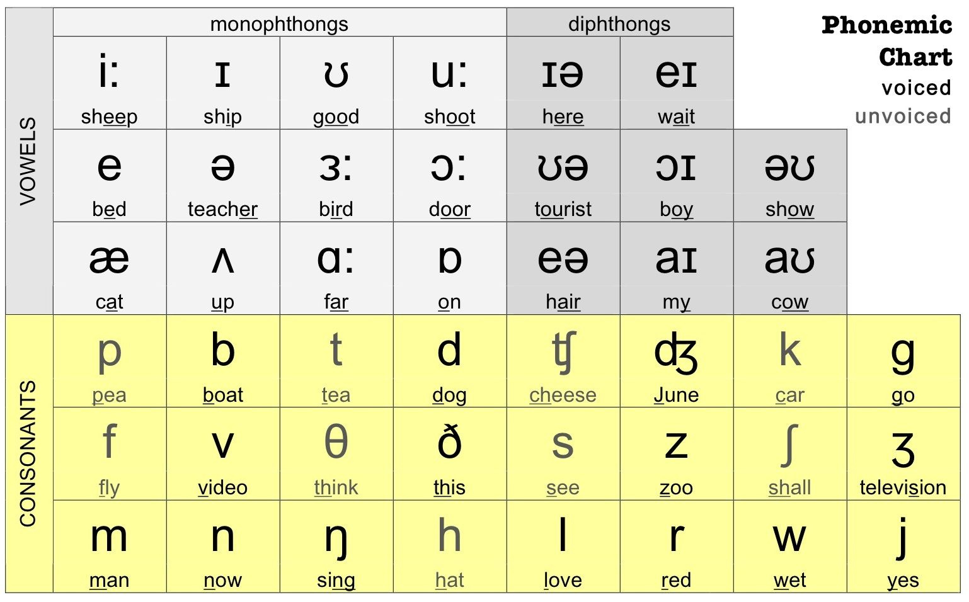
#THEHOMESCHOOLLIFE

Slide 3
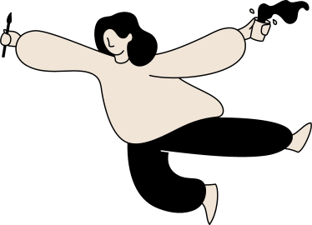
/ɑː/
Calm
Far
Party
/kɑːm/
You need to Calm down!
/fɑːr/
How far is it from your house?
/ˈpɑːti/
Let’s have a party!
#THEHOMESCHOOLLIFE

Slide 4
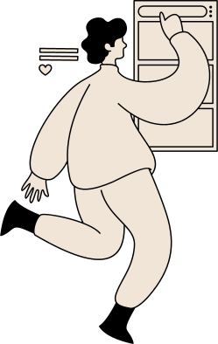
/ɒ/
On
Hot
Top
/hɒt/
It’s boiling hot today.
/tɒp/
Ryan is top in Physics.
/ɒn/
Turn on the light!
#THEHOMESCHOOLLIFE

Slide 5
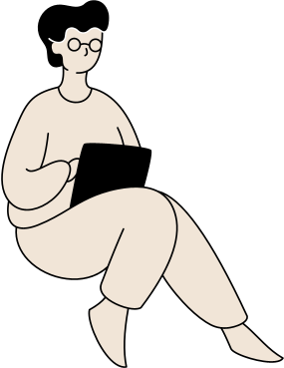
/eɪ/
Say
Favorite
Day
/seɪ/
What did you say?
/ˈfeɪ.vər.ət/
Taylor Swift is my favorite singer.
/deɪ/
How was your day going?
#THEHOMESCHOOLLIFE

Slide 6
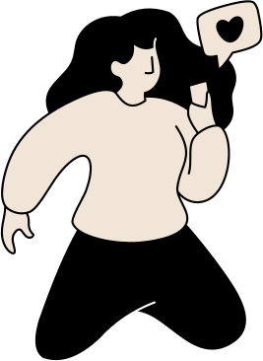
/aɪ/
Sunshine
Tight
Motorbike
/ˈsʌnʃaɪn/
You are my sunshine.
/taɪt/
I loosened the tight screws.
ˈməʊ.tə.baɪk/
I go to work by motorbike.
#THEHOMESCHOOLLIFE

Slide 7

/ɔɪ/
Boy
Employee
Enjoy
/bɔɪ/
What a handsome boy!
/ɪmˈplɔɪ.iː/
I am an employee at a bank.
/ɪnˈdʒɔɪ/
Enjoy your meal!

Slide 8
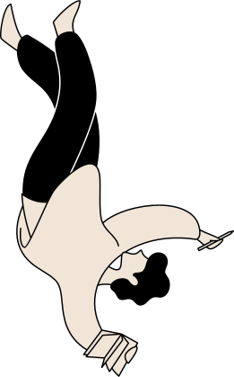
/aʊ/
House
Town
Sound
/haʊs/
This is a two-storey house
/taʊn/
I live in a small town.
/saʊnd/
That sounds good!
#THEHOMESCHOOLLIFE

Slide 9
/əʊ/
Blow
Telephone
Focus
/bləʊ/
The wind is blowing harder.
/ˈtel.ɪ.fəʊn/
What’s the telephone number?
/ˈfəʊ.kəs/
Focus on the lesson.

Slide 10
/ɪə/
Beer
Year
Career
/kəˈrɪəʳ/
Study for your career.
/bɪər/
I love drinking beer.
/jɪə/
Happy New Year!

Slide 11
/eə/
Airline
Careful
Bear
/ˈeə.laɪn/
How many airlines did you fly?
/ˈkeə.fəl/
You should be careful.
/beər/
I couldn't bear to see the dog in pain.

Slide 12
/ʊə/
Usually
Casual
Pure
/ˈjuːʒʊəlɪ/
We usually go by motorbike.
/ˈkæʒ.ju.əl/
I want to buy a new casual watch.
/pjʊə/
My shirt is 100% pure cotton.

Slide 13

/p/
/b/
Pea
Bee
/piː/
I love to eat peas.
/biː/
I was stung by a bee.

Slide 14
/p/
/b/
Perfect
Bitter
/ˈpɜː.fekt/
Practice makes perfect.
/ˈbɪt.ər/
Bitter melon is my favorite.

Slide 15

/t/
/d/
Teammate
Damage
/ˈtiːm.meɪt/
She is my great teammate.
/ˈdæm.ɪdʒ/
My house was badly damaged after the earthquake.

Slide 16
/t/
/d/
Commit
Suicide
/kəˈmɪt/
Don't commit a crime.
/ˈsuː.ə.saɪd/
A lot of suicides occur in prison.

Slide 17

/k/
/g/
Collect
Gear
/kəˈlekt/
A stamp collection.
/ɡɪr/
I got my camping gear ready.

Slide 18
/k/
/g/
Milk
Hungry
/mɪlk/
Condensed milk
/ˈhʌŋ.gri/
A hungry belly.

Slide 19
/s/
/z/
Sample
Zoo
/ˈsæm.pəl/
A random sample of population.
/zuː/
Zoos are shut down during the pandemic.
#THEHOMESCHOOLLIFE

Slide 20
/s/
/z/
Price
Prize
/praɪs/
A reasonable price.
/praɪz/
Who got the first prize?
#THEHOMESCHOOLLIFE

Slide 21
/f/
/v/
Feature
Volunteer
/'fɪːtʃə(r)/
The latest version of iphone has several new feature.
/ˌvɒl.ənˈtɪəʳ/
I want to become a volunteer.

Slide 22
/f/
/v/
Stiff
Cave
/stɪf/
This hair spray makes my hair stiff.
/keɪv/
Son Doong cave has been discovered.

Slide 23
/ʃ/
Shoulder
Relationship
Cherish
/ˈʃoʊl.dɚ/
Put your hands on my shoulder.
/rɪˈleɪ.ʃən.ʃɪp/
A long-distance relationship.
/ˈtʃer.ɪʃ/
I cherish the time we've been together.

Slide 24
/ʒ/
Decision
Television
Pleasure
/ˈtel.ɪ.vɪʒ.ən/
Most homes have a television.
/ˈpleʒ.əʳ/
It’s my pleasure!
/dɪˈsɪʒ.ən/
Make a decision.

Slide 25
/tʃ/
Cheek
Research
Teach
/tʃiːk/
She has rosy cheeks.
/rɪˈsɝːtʃ/
A medical research.
/tiːtʃ/
Every failure teaches me great lessons.

Slide 26
/dʒ/
Ginger
Language
Individual
/ˈdʒɪn.dʒɚ/
Ginger tea tastes really good.
/ˈlæŋ.gwɪdʒ/
English is not my native language.
/ˌɪn.dəˈvɪdʒ.u.əl/
Every individual has a right to live.

Slide 27
/θ/
Healthy
Thank
Teeth
/ˈhel.θi/
A healthy diet.
/θæŋk/
I just want to say thank you.
/tiːθ/
I'm brushing my teeth.

Slide 28
/ð/
This
Although
Weather
/ðɪs/
This guy is humerous.
/ɑːlˈðoʊ/
He has a successful career although he doesn't go to college.
/ˈweðə/
How's the weather today?

Slide 29
/h/
Happy
Heart
Whose
/ˈhæp.i/
She has a happy smile.
/hɑːrt/
My heart is you.
/huːz/
Whose pen is it?

Slide 30
/j/
Year
Young
Mute
/jɪr/
Happy new year!
/jʌŋ/
Young children are naive.
/mjuːt/
Please, mute your mic.

Slide 31
/l/
Lemon
Likelihood
Possible
/ˈlaɪ.kli.hʊd/
A likelihood of overpopulation.
/ˈlem.ən/
A slice of lemon
/ˈpɒsəbļ/
as soon as possible

Slide 32
/m/
Money
Family
Lime
/ˈmʌni/
money income
/ˈfæməli/
I love my family
/laɪm/
Limes have a sour taste.

Slide 33
/n/
Night
Banana
Nine
/naɪt/
Have a good night!
/bəˈnæn.ə/
A bunch of bananas.
/naɪn/
I go to bed at nine.

Slide 34
/ŋ/
Singer
England
Morning
/ˈsɪŋ.ɚ/
She is a good singer.
/ˈɪŋ.ɡlənd/
Let’s travel to England!
/ˈmɔː.nɪŋ/
Morning exercises.

Slide 35
Thank you for today's lesson!

